Slide 1
Investment Recommendation System
SKILLORBIT CAPSTONE · INVESTMENT BANKING WITH FINANCE
AS OF 16 OCT 2026
7
Buy
12
Hold
Ranking 28 Nifty 50 stocks by risk and return, and labelling each one Buy, Hold or Sell.
9
Sell
Notes:
Welcome. This project ranks 28 Nifty 50 stocks by risk and return, then labels each one Buy, Hold or Sell with a reason. The panel on the right is the result as of 16 October 2026: 7 Buy, 12 Hold and 9 Sell. I will show how the data was prepared, how the scores work, what the results say, and then the live dashboard.

Slide 2
Five steps from raw prices to a clear Buy, Hold or Sell
1
2
3
4
5
Collect
Clean
Score
Recommend
Show
Five years of daily prices for 28 Nifty 50 stocks and the index, from Yahoo Finance.
Remove 57 placeholder rows, align every stock to the same 1,233 trading days.
Measure return, volatility, drawdown, beta, trend and momentum, then combine them.
Turn each total score into Buy, Hold or Sell, with a risk level alongside.
A five-page Streamlit dashboard, live on the web, to explore and compare.
Each step is a notebook in the GitHub repo
2
Notes:
The pipeline has five steps, and each one is a notebook or a script in the GitHub repo. We collect five years of prices, clean them, score every stock, convert the scores to recommendations, and show everything in a dashboard. The next slides go through each step.

Slide 3
28 stocks across 8 sectors, five years of daily prices
28
8
1,233
Nifty 50 stocks
Sectors
Common trading days
Banking
IT
Energy
FMCG
Pharma
Auto
Metals
Infra and others
Source: Yahoo Finance through yfinance, with the Nifty 50 index as the benchmark. Cleaning removed 57 placeholder rows with no recorded trading, and kept only the days when every stock traded.
Notebooks 01 and 02
3
Notes:
The data covers 28 Nifty 50 stocks in 8 sectors, plus the Nifty 50 index as a benchmark. It comes from Yahoo Finance through the yfinance library. Cleaning removed 57 placeholder rows with no recorded trading, and we kept only the 1,233 days on which every stock traded, so all comparisons are like for like.

Slide 4
Two scores decide every recommendation
Risk score, 0 to 100
Total score, 0 to 100
40% volatility, how much the price swings
35% Sharpe ratio, return for the risk taken
40% maximum drawdown, the worst fall
25% safety, which is 100 minus the risk score
20% beta, sensitivity to the Nifty 50
25% trend, from the 50 and 200 day averages
Low under 33, Medium 33 to 66, High over 66
15% momentum, the last six months
Buy at 60 or more, Sell under 35, otherwise Hold
Weights are judgement calls. Each measure is scaled across the 28 stocks.
4
Notes:
Every recommendation comes from two scores. The risk score blends volatility, the worst fall from a peak, and beta, so it says how bumpy the ride has been. The total score rewards return for the risk taken, safety, trend and recent momentum. Above 60 is a Buy, below 35 a Sell, and the middle is a Hold. The weights are judgement calls, and risk levels are relative to these 28 stocks.

Slide 5
The result: 7 Buy, 12 Hold and 9 Sell
7
12
9
Buy
Hold
Sell
Total score of 60 or more. Strong return for the risk taken.
Total score from 35 to 60. Mixed signals, so keep watching.
Total score under 35. Weak return or a downtrend.
ICICI Bank, Bharti Airtel, Sun Pharma, Bajaj Auto, Kotak Bank, Cipla, Nestlé India
Examples: M&M, SBI, NTPC, L&T
Examples: TCS, ITC, ONGC, Infosys, Reliance, Wipro
As of 16 Oct 2026, from 28 stocks
5
Notes:
Here is the outcome. Seven stocks are a Buy, led by ICICI Bank, Bharti Airtel and Sun Pharma. Twelve are a Hold, and nine are a Sell, including the large IT names TCS, Infosys and Wipro, and also ITC, ONGC and Reliance. These labels reflect the past five years of prices, not a forecast.

Slide 6
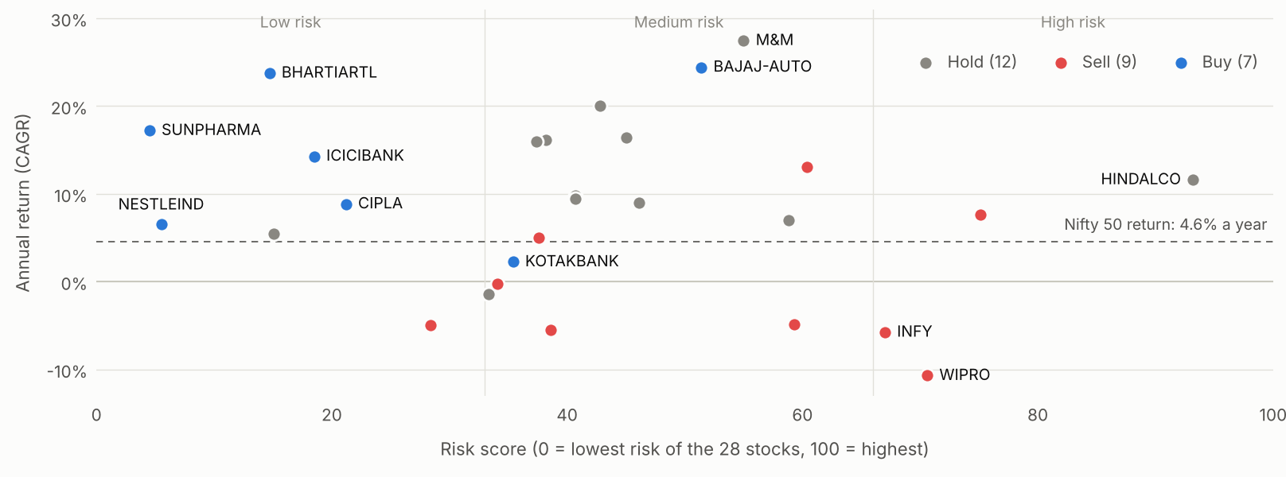
Bharti Airtel, Sun Pharma and ICICI Bank earned 14% to 24% a year at risk scores under 20
Five years to 16 Oct 2026. Risk levels are relative to these 28 stocks.
6
Notes:
Each dot is a stock. Left means lower risk, higher means more annual return. The best place to be is top left. Bharti Airtel, Sun Pharma and ICICI Bank earned between 14 and 24 percent a year with risk scores under 20. Bajaj Auto earned the most but with a much higher risk score. The dashed line is the Nifty 50 at 4.6 percent a year, and most stocks beat it.

Slide 7
The seven Buy stocks, ranked by total score
Stock
Sector
Annual return
Risk level
Trend
Total score
ICICI Bank
Banking
14.3%
Low
Uptrend
80.6
Bharti Airtel
Infra / others
23.8%
Low
Sideways
79.0
Sun Pharma
Pharma
17.2%
Low
Sideways
75.4
Bajaj Auto
Auto
24.4%
Medium
Sideways
69.5
Kotak Bank
Banking
2.3%
Medium
Uptrend
67.6
Cipla
Pharma
8.9%
Low
Sideways
62.0
Nestlé India
FMCG
6.6%
Low
Sideways
60.1
Kotak Bank earned only 2.3% a year. It is a Buy because it is in an uptrend with strong six-month momentum, which shows the score is not return alone.
Annual return is CAGR over five years
7
Notes:
These are the seven Buy stocks. Five of the seven carry a Low risk level. ICICI Bank leads with a score of 80.6, helped by being in an uptrend. Kotak Bank is the interesting case: its five-year return is only 2.3 percent a year, but it is in an uptrend with strong recent momentum, so the score lifts it above the Buy line.

Slide 8
The market is in a weak patch: 13 stocks are in a downtrend and only 2 in an uptrend
2
13
13
Uptrend
Sideways
Downtrend
Nifty 50 return by year
Sectors by average total score
2022
+4.3%
Pharma
64.8
2023
+20.0%
Banking
57.6
2024
+8.8%
IT
34.2
2025
+10.5%
Metals
31.6
2026 so far
-11.4%
21 of 28 stocks fell over the last six months
8
Notes:
Zooming out to the market. Only ICICI Bank and Kotak Bank are in an uptrend, 13 stocks are moving sideways and 13 are in a downtrend. The Nifty 50 is down about 11 percent so far in 2026 after four good years, and 21 of the 28 stocks fell over the last six months. By sector, Pharma and Banking score best on average, while IT and Metals score worst.

Slide 9
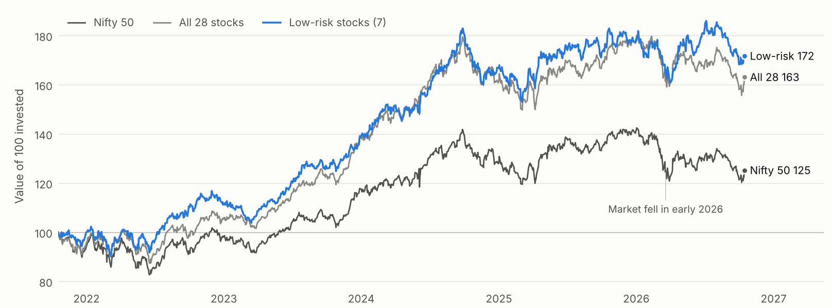
100 invested in the Low-risk stocks grew to 172, against 125 in the Nifty 50
Equal-weighted. Stocks include dividends, the Nifty line is price-only.
9
Notes:
This chart shows what 100 rupees would have become over five years. The seven Low-risk stocks grew to about 172, all 28 stocks to about 163, and the Nifty 50 to about 125. The Low-risk group also had a slightly lower maximum fall. A caution: the 28 stocks are today's index members, which flatters the result, and this is in-sample, so it is not a forecast. Stock prices include dividends while the Nifty line is price-only.

Slide 10
A live five-page dashboard to explore the results
Overview
Stock Explorer
Compare Stocks
Portfolio Builder
Risk vs Return
All 28 recommendations at a glance
Price chart and metrics for one stock
Put several stocks side by side
Pick stocks and see combined return and risk
Every stock plotted by risk and return
Live app
investment-recommendation-system-bnw27gg3puetznkcc3st2u.streamlit.app
GitHub
github.com/natashajenovavalluru007S/investment-recommendation-system
Built with Streamlit and Plotly, deployed on Streamlit Cloud
10
Notes:
Now the live dashboard. It has five pages. Overview shows all recommendations. Stock Explorer shows one stock in detail. Compare Stocks puts several side by side. Portfolio Builder lets you pick stocks and see the combined return and risk. Risk vs Return plots every stock. Open the live link and click through each page in the demo.

Slide 11
What to keep in mind, and what comes next
Limitations
Next steps
The 28 stocks are today's index members, so failed or removed companies are missing.
Add all 50 Nifty stocks and refresh the data automatically.
Bring in fundamentals such as earnings growth and valuation.
Results are in-sample, and the window is only five years.
Test the signals on data the scores have not seen.
The score uses price history only, with no earnings or valuation data.
Let users change the weights in the dashboard.
Weights are judgement calls, and risk levels are relative to these 28 stocks.
This is a learning project, not financial advice
11
Notes:
Some honest limits. The 28 stocks are today's index members, so the results flatter the market through survivorship bias. Everything is measured on the same data used to build it, over a short window, and it uses price history only. The weights are judgement calls. For next steps: all 50 stocks, fundamentals, out-of-sample testing, and adjustable weights in the dashboard. This is a learning project and not financial advice.

Slide 12
Thank you
Questions are welcome. The code, notebooks and dashboard are all open to explore.
Live app
investment-recommendation-system-bnw27gg3puetznkcc3st2u.streamlit.app
GitHub
github.com/natashajenovavalluru007S/investment-recommendation-system
Notes:
That is the project. To recap: 28 stocks, a transparent score, 7 Buy, 12 Hold and 9 Sell, and a live dashboard anyone can use. Thank you, and I am happy to take questions.

